Slide 1


Objectives
In this session, you will learn to:
  Design an HTML form
  Manipulate the components of a Web page

Slide 2
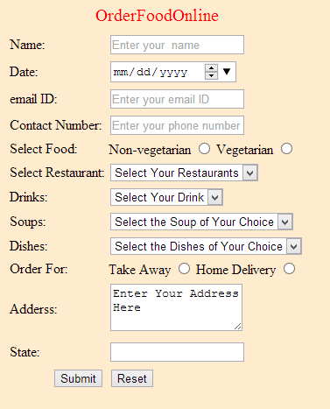


Designing an HTML Form
Scenario:
Use the animation, HTML_05_CreatingandProcessingForms.swf, to understand the concept of forms.
Customers need to provide various details in an online form
Facilitates customers to place online orders

Slide 3
Creating Forms
Forms:
  Are interactive Web pages that are used to accept user input.
  Comprises input fields that enable the user to fill and submit the
  information to a website.

Slide 4
Creating Forms (Contd.)
The <FORM> tag:
  Is used to create an HTML form.
  Has the following syntax:
    <FORM [attribute list]>
    ..
    ..
    </FORM>
  Supports the following attributes:
name
ID
action
method
autocomplete
novalidate
target

Slide 5
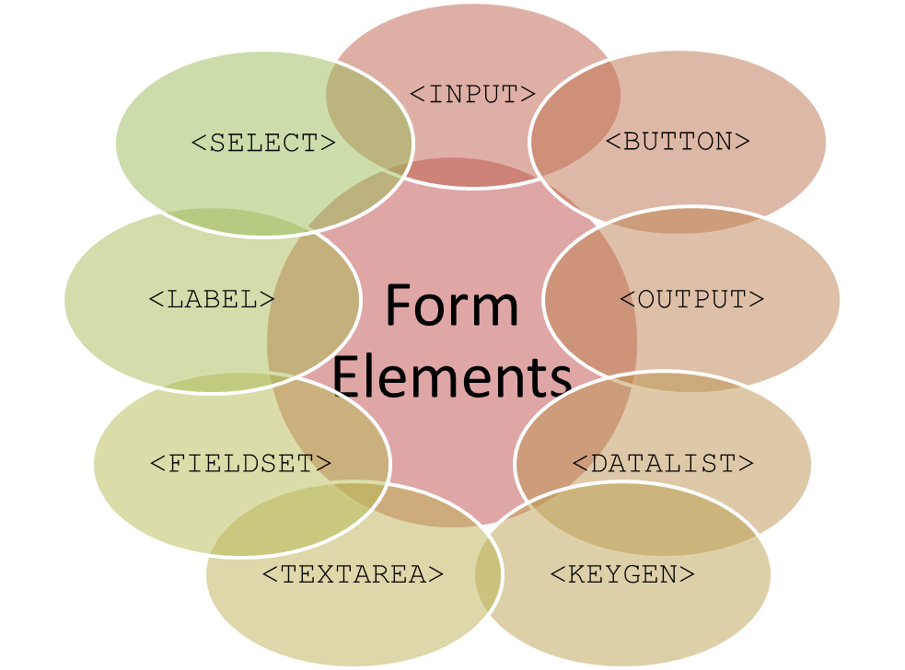
Exploring Form Elements
Form elements:
  Are the input fields added to a form that are used for accepting user input.
  Are added to a form using the following tags:

Slide 6
Exploring Form Elements (Contd.)
The <INPUT> tag:
  Is used to create input fields inside a form.
  Has the following attributes:
type
value
name
ID
autocomplete
autofocus
required
pattern
placeholder

Slide 7
Exploring Form Elements (Contd.)
The <SELECT> tag:
  Is a container tag that creates a drop-down list on the form.
  Has the following attributes:
    multiple
    name
    size
    autofocus
    form

Slide 8
Exploring Form Elements (Contd.)
The <OPTION> tag:
  Is used within the <SELECT> tag to create a list of options in the drop-down list.
  Has the following attributes:
    selected
    value
    disabled

Slide 9
Exploring Form Elements (Contd.)
The <OPTGROUP> tag:
  Is used to group the related options in one group.
  Has the following attributes:
    disabled
    label

Slide 10
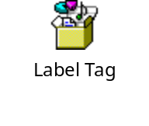
Exploring Form Elements (Contd.)
The <LABEL> tag:
  Is used to define a label for the input fields.
  Has the following attributes:
    for
    form
  The following embedded Notepad file contains the code that enables you to
  understand the <LABEL> tag:

Slide 11
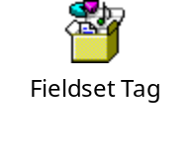
Exploring Form Elements (Contd.)
The <FIELDSET> tag:
  Is used to combine and group related fields in a form.
  Creates a box around the selected fields.
  Uses the <LEGEND> tag to define a caption for the fieldset.
  The following embedded Notepad file contains the code that enables you to understand the
  <FIELDSET> tag:

Slide 12
Exploring Form Elements (Contd.)
The <TEXTAREA> tag:
  Creates a field in which the user can enter a large amount of text.
  Has the following attributes:
    rows
    cols
The <DATALIST> tag:
  Is used to create a list of predefined options for an input field.
  Is used to provide an autocomplete feature on input fields.

Slide 13
Exploring Form Elements (Contd.)
The <KEYGEN> tag:
  Is used to specify a key-pair generated field in a form.
  Has the following attributes:
    autofocus
    disabled
    name
    keytype
    form

Slide 14
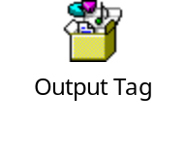
Exploring Form Elements (Contd.)
The <OUTPUT> tag:
  Is used to represent the result of a calculation.
  Has the following attributes:
    for
    form
    name
  The following embedded Notepad file contains the code that enables you to
  understand the <OUTPUT> tag:

Slide 15
Exploring Form Elements (Contd.)
The <BUTTON> tag:
  Is used to create a button.
  Has the following attributes:
    type
    disabled
    name
    autofocus
    form

Slide 16
Just a Minute
Which one of the following attributes is used to ensure that the form element has
the focus when the Web page loads?
  placeholder
  autofocus
  formtarget
  formnovalidate

Slide 17
Just a Minute (Contd.)
Solution:
  autofocus

Slide 18
Demo: Designing an HTML Form
Problem Statement:
  You have been assigned the task to design a form for online booking of movie tickets on the ShowOnWheels website. For this, you need to design the Online Booking Web page. The page needs to be designed according to the following guidelines:
    The page should display the form with the header, Book Your Tickets Online.
    It should have various fields, such as Name, Date of Bookings, Movie, Show Timings, Select Class, Price, Number of Tickets, and Total Price.
    The title of the movies and show timings should be displayed in a
    drop-down list.
    The form should have provision to accept the class that the customer would prefer as platinum, gold, and exclusive.
    The Price and Total Price fields should be disabled.
    The form should have two buttons, Submit and Reset.
    The Web page should display the alerts and updates to the users on the right side of the form.
  How will you implement the preceding tasks to create the desired form?
  Prerequisite: You need to use the ShowOnWheels file that you have created in Activity 4.1 to perform this activity. Ask your faculty to provide you the same.

Slide 19
Demo: Designing an HTML Form (Contd.)
Solution:
  To create a form for online booking of movie tickets, you need to perform the
  following tasks:
    1. Create the OnlineBooking.html file.
    2. Apply styles on elements.
    3. Update the nav.html file.
    4. View the form.

Slide 20
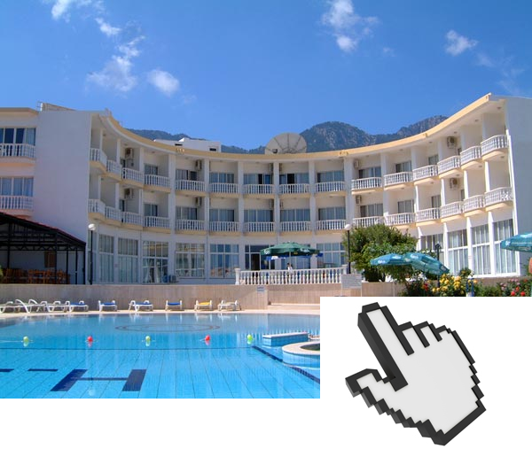
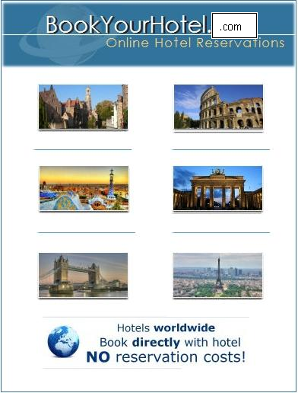
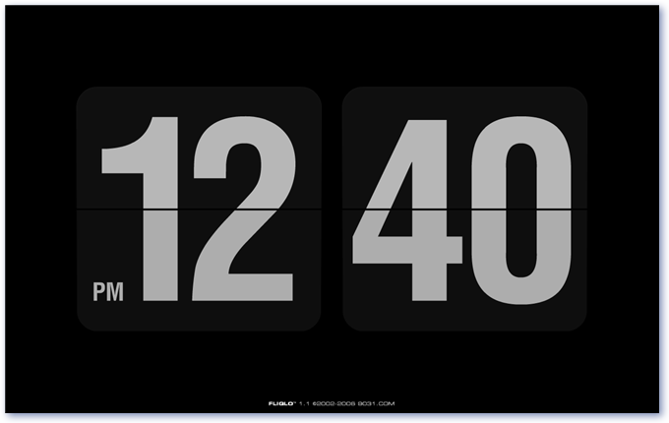
Manipulating the Components of a Web Page
Scenario:
Enables the customers to access the online booking form for each hotel by clicking on the image of the hotel
Displays a clock, which is dynamically updated every second to display the current time to the users

Slide 21
Manipulating the Components of a Web Page (Contd.)
JavaScript:
  Is used to add dynamism and interactivity to Web pages.
  Is an object-based language and treats every element as an object.
  Provides various types of built-in objects, which help to make a Web page dynamic
  and interactive.

Slide 22
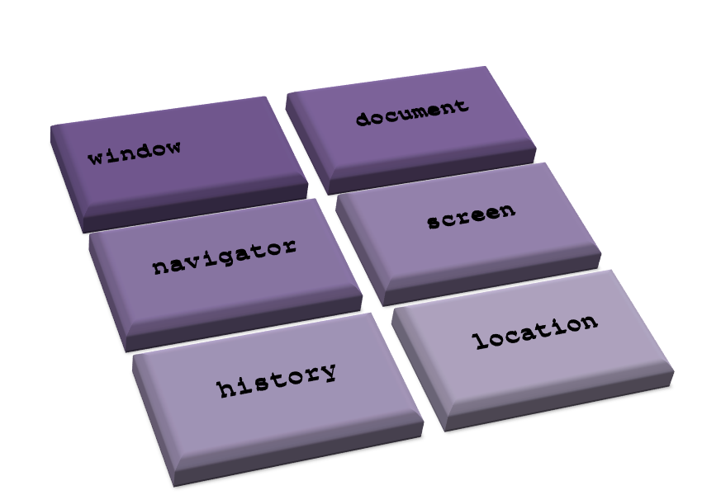
Working with Browser Objects
Browser objects:
  Define the browser content and the browser itself.
  Enable retrieval and manipulation of information about a browser.
  Are of the following types:

Slide 23
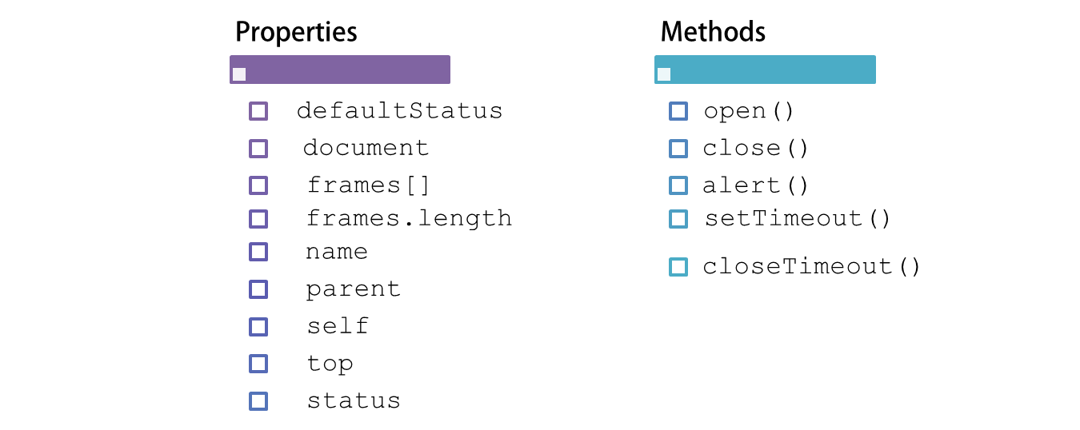
Working with Browser Objects (Contd.)
The window object:
  Represents a browser window, which displays the document.
  Has the following properties and methods:

Slide 24
Working with Browser Objects (Contd.)
The document object:
  Is subordinate to the window object in the document object model hierarchy.
  Represents the HTML document that is loaded in the Web browser window.
  Provides the following properties:
  Provides the following methods:
alinkColor
anchors[]
bgColor
cookie
fgColor
forms[]
linkColor
lastModified
links[]
referrer
title
vlinkColor
write()
writeln()
getElementsByName()
getElementsByTagName()
getElementById()

Slide 25
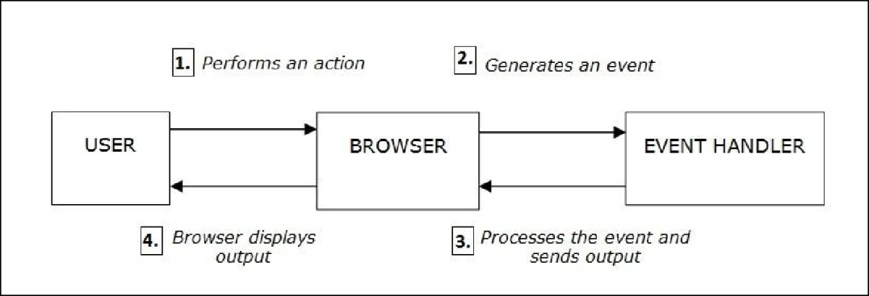
Working with Browser Objects (Contd.)
An event is an action that happens on a Web page.
  The function that is executed in response to an event is called an event handler.
  The following figure displays the event handling process.

Slide 26
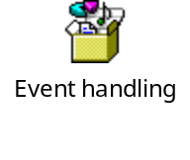
Working with Browser Objects (Contd.)
  The following events are supported by JavaScript:
  The following embedded Notepad file contains the code to implement events and event handlers:
onblur
onmouse
down
ondblclick
onload
onmousemove
onerror
onchange
onfocus
onkeypress
onmouse
out
onselect
onclick
onclick
onkey
down
onkeyup
onmouse
over
onmouse
up

Slide 27
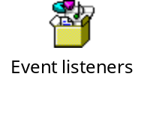
Working with Browser Objects (Contd.)
An event listener:
  Is an object that waits for an event to occur and performs certain actions corresponding to it.
  Needs to be registered with an event handler using the following syntax:
  addEventListener(type, listener[, useCapture]);
  The following embedded Notepad file contains the code that explains the working of event listeners:

Slide 28
Summary
In this session, you learned that:
  To create a form on a Web page, you need to use the <FORM> tag.
  The <FORM> tag supports the following attributes:
    name
    ID
    action
    method
    autocomplete
    novalidate
    target
  The fields can be added to a form by using the following tags:
    <INPUT>
    <SELECT>
    <LABEL>
    <FIELDSET>
    <TEXTAREA>
    <DATALIST>
    <KEYGEN>
    <OUTPUT>
    <BUTTON>
  Browser objects enable retrieval and manipulation of information about a browser.

Slide 29
Summary (Contd.)
  The window object represents a browser window, which displays the document.
  The document object represents the HTML document that is loaded in the Web browser window.
  An event is an action that happens on a Web page.
  An event listener is an object that waits for an event to occur and performs
  certain actions corresponding to it.

